Slide 1
Data Migration Workshop
Module 1-2 (File Gateway)

Slide 2
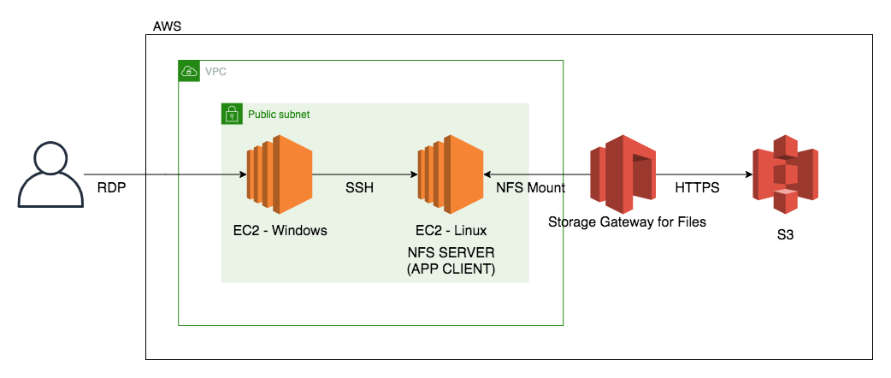
Architecture

Slide 3
Costing
Resource | Cost
EC2 - Windows – c5.xlarge | $0.354000 hourly (On – demand)
EC2 - Linux – m5.xlarge | $0.192000 hourly (On – demand)
Storage Gateway for Files | $0.01 per GB written to S3
S3 Standard | $0.023 per GB (first 50 TB / month)

